Slide 1
Converting Percent, Decimals and Fractions
Miss L
Year 11 Essentials

Slide 2

Learning Intentions
Students will be able to
Converting numbers to fractions, percentages and decimals
WICOR

Slide 3
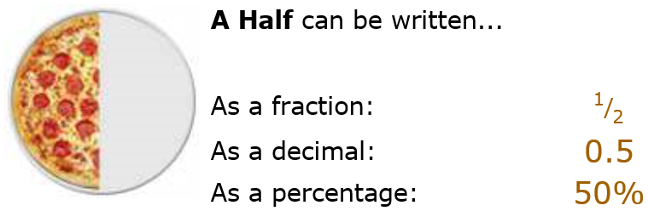
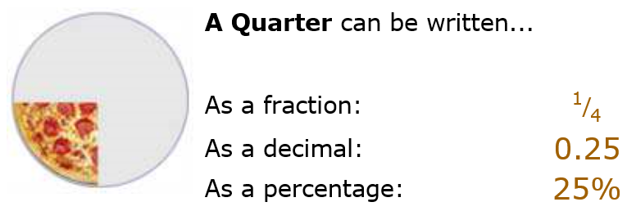
24
7
30
Number Review
Date
EQ – How do we convert decimals into fractions and percentages???
Decimals, Fractions and Percentages are just different ways of showing the same value:

Slide 4
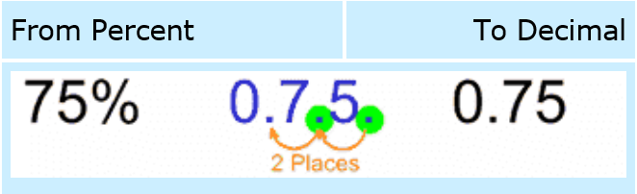

24
7
30
Number Review
Date
EQ – How do we convert decimals into fractions and percentages???
Converting From a Percent to a Decimal
Step 1: divide by 100, and remove the "%" sign.
The easiest way to divide by 100 is to move the decimal point 2 places to the left:

Slide 5
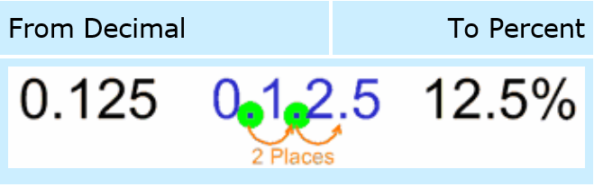
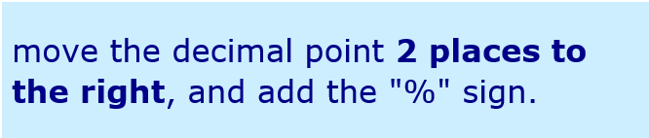
24
7
30
Number Review
Date
EQ – How do we convert decimals into fractions and percentages???
From Decimal to Percent
Step 1: multiply by 100, and add a "%" sign.
The easiest way to multiply by 100 is to move the decimal point 2 places to the right:

Slide 6
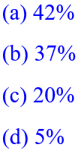
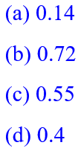
Practice
Write these percentages as decimals:
Write these decimals as percentages:

Slide 7
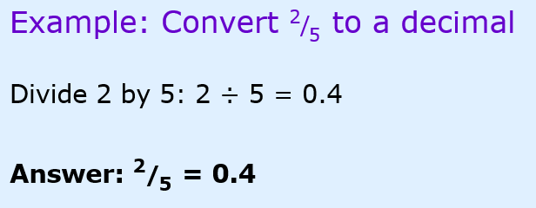
24
7
30
Number Review
Date
EQ – How do we convert decimals into fractions and percentages???
From Fraction to Decimal
Step 1: Divide the top number by the bottom number
(divide the numerator by the denominator in mathematical language)

Slide 8


Practice
Write these percentages as fractions in their simplest form:
Write these fractions as percentages:

Slide 9


Slide 10
Task
Complete worksheet

